Slide 1
Chapter 11

Slide 2
Translocation of organic materials
Nature of Science
Evidence for the translocation of
organic materials in phloem
Ringing experiment
Radioisotopes
Aphid feeding

Slide 3
Evidence 1 –
Ringing experiment
Radioisotopes

Slide 4
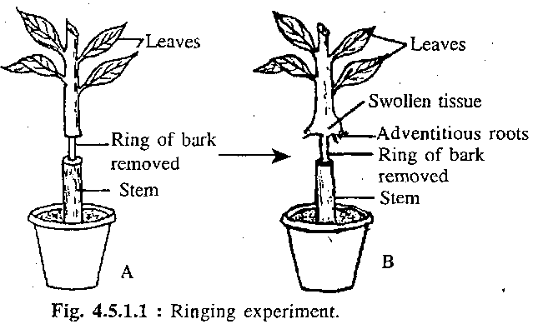
How to find out the tissue for sugar transport?
Ringing experiment (1700s, Marcello Malpighi)
Radioactive carbon

Slide 5
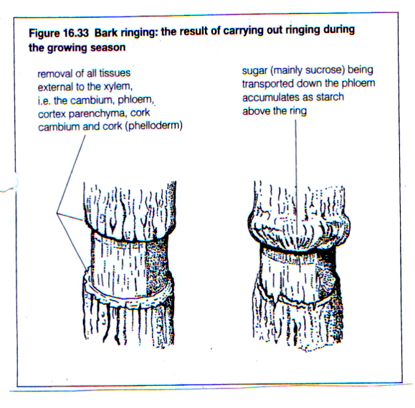
Days / weeks after ringing.
Why does it appear as such?
Immediately after ringing

Slide 6
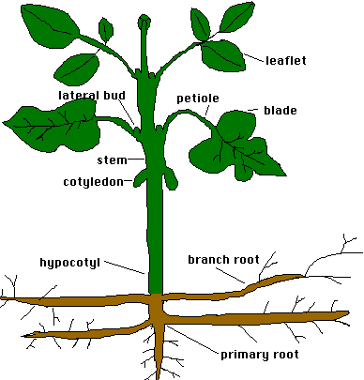
Where are the sources of the organic substance?
Where are the sinks / destinations of the organic substances?
Direction of translocation of organic substance, to…

Slide 7
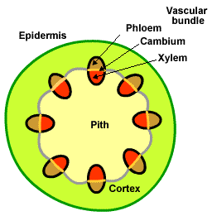
Which tissues will be ‘ringed’?

Slide 8
When there is no “through road” after it was ringed, organic nutrients tend to accumulate at the
top / bottom
part of the ringed stem.
Direction of translocation of organic substance, to…

Slide 9
organic nutrients accumulated at the top part of the ringed stem means more nutrients available for growth and cell division.
Hence the top part of the ring swells up.
Direction of translocation of organic substance, to…

Slide 10
Evidence 2 –
Radioactive isotope

Slide 11
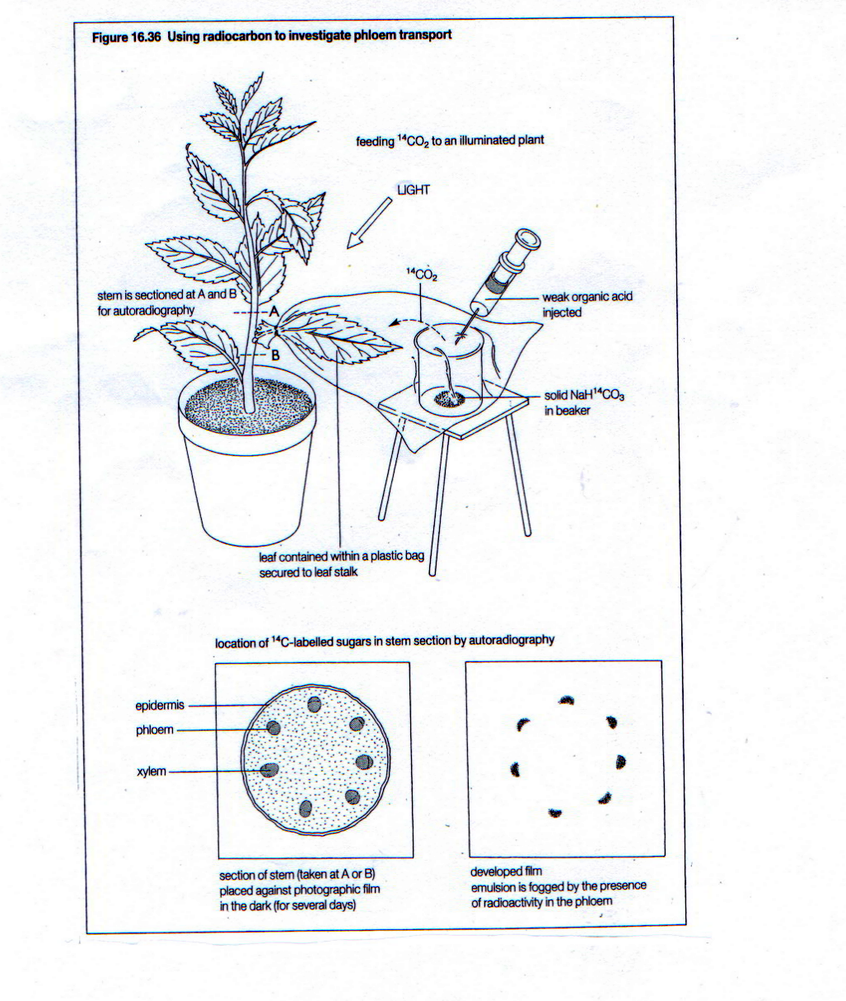
Expt to find out which tissue is responsible for translocation of organic substances
¹⁴CO₂ is given to a special leaf
For ______________
photosynthesis
Organic substances / sugar
______________ with radioactivity are formed.
Cut a cross section of the stem of this plant.
Put the section onto a photographic film.
The radioactivity can be revealed by autoradiography.

Slide 12
Part that shows radioactivity.
Make a comparison with the cross section of the stem.
The part that shows radioactivity is the phloem.
Hence, phloem translocates the organic substances made by leaves in photosynthesis to other destinations that need them

Slide 13
Evidence 3 –
Aphids

Slide 14
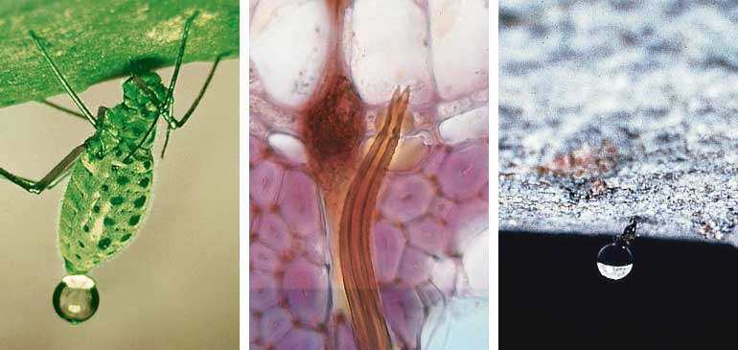
Tapping phloem sap with the help of an aphid
Aphids feed on organic substances made by the plant.
Find out exactly what it is feeding, via which tissue in the plant was it fed.

Slide 15
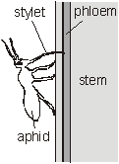
A feeding aphid is anaesthetised
Its mouthpart is cut
Sap in the sieve tube flows out slowly via the mouthpart
Analyze the sap contents
sugar & amino acids
Sieve tubes in phloem are responsible for transport of organic nutrients

